Slide 1

Project Proposal Presentation Project Title: Image Text to Speech Conversion Using Azure Cognitive Services
CSE-719 : Multimedia Systems

Slide 2
Submitted By :
Submitted To :
Group - 01
Dr. Md. Ashraful Alam, PhD
Assistant Professor,
Department of CSE,
BRAC University
Shanuma Afrin Meghla
ID: 21166010
Israt Jahan Ritun
ID: 21166038
Khan Md. Hasib ID: 20266015
Rashik Hasnat
ID: 20266010
CSE-719 : Multimedia Systems

Slide 3
Outline
Introduction
Objective
Background Study
Work Flow Diagram
Tools and Resources
Code and Results
Conclusion and Future Work

Slide 4
Introduction

Slide 5
Introduction
Many news organizations and television outlets have a large number of images in their hands, which they normally keep in some sort of digital repository.
Saving a new photo, they must also tag related people in the photo so that the photo can be identified later by searching for the person's name.
In this project, we intend to tackle a problem that no other standard approach has addressed: training a facial recognition model with group images of multiple faces without a clear face rectangle.

Slide 6
Introduction (Cont')
Again, visual impairment is one of the biggest limitation for humanity, especially in this day and age when information is communicated a lot by text messages rather than voice.
The captured image undergoes a series of image pre-processing steps to locate only that part of the image that contains the text.
We convert the text of images into speech using Azure Cognitive Services.

Slide 7
Objective

Slide 8
Objective
In our planet of 7.4 billion humans, 285 million are visually impaired out of whom 39 million people are completely blind, i.e. have no vision at all, and 246 million have mild or severe visual impairment (WHO, 2011).
It has been predicted that by the year 2020, these numbers will rise to 75 million blind and 200 million people with visual impairment.
As reading is of prime importance in the daily routine (text being present everywhere from newspapers, commercial products, sign-boards, digital screens etc.) of mankind, visually impaired people face a lot of difficulties.

Slide 9
Objective (Cont’)
Our work assists the visually impaired by reading out the text from the photo collection.
The primary goal of this project to train and test photos to recognize faces without requiring the user to directly tag the face rectangle the model should be able to benefit from images that have many faces and tags.
Then convert the image to speech using Azure Cognitive Services.

Slide 10
Background Study

Slide 11
Facial Recognition
A Facial recognition is a category of biometric software that maps an individual's facial features mathematically and stores the data as a face print.
Usages: Unlocking Phones, Law enforcement, Banking, Healthcare etc.
In our project, we work on that facial recognition in the first phase of our workflow diagram.

Slide 12
Text Recognition
Optical Character Recognition (OCR) is the use of technology to distinguish printed or handwritten text characters inside digital images of physical documents
Practical applications: updating inventory, analyzing documents, scene understanding, robot navigation, and image retrieval.
In our project, we work on that text recognition from images using OCR.

Slide 13
Text-to-speech conversion
Text-to-speech (TTS) is a type of speech synthesis application that is used to create a spoken sound version of the text in a computer document.
Helpful for kids who struggle with reading, for visually impaired people etc.
In our project, we convert text into speech using Azure Cognitive Services.

Slide 14
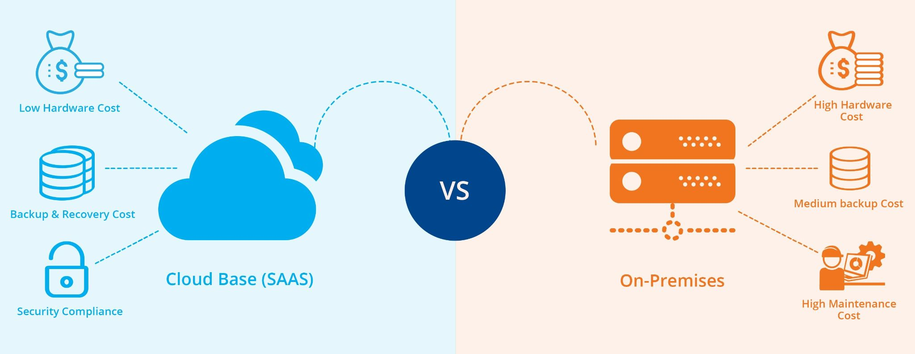

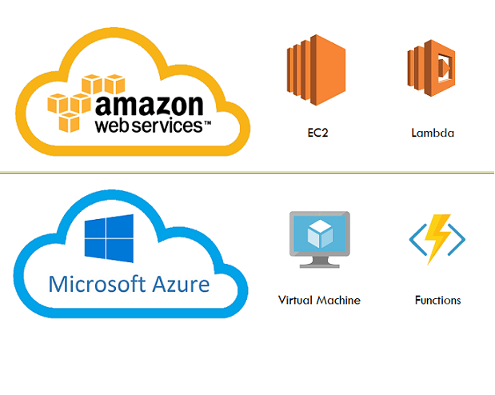
Different Architecture
Serverless
Traditional

Slide 15
Work Flow Diagram

Slide 16
Work Flow Diagram
In our project we divided our workflow diagram into two phases:
Phase-I : Facial Identification
Phase-II: Image Text to Speech Recognition

Slide 17
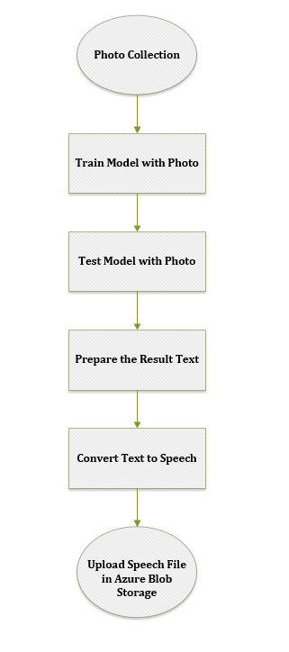
Phase-I: Facial Identification
Figure: Workflow Diagram of Face Identification

Slide 18
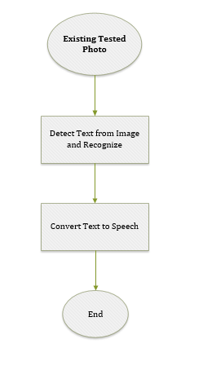
Phase-II: Image Text to Speech Recognition
Figure: Workflow Diagram of Image Text to Speech Recognition

Slide 19
Tools and Resources

Slide 20
Tools and Resources
Frontend: Angular 6, Bootstrap
Backend: .Net core (Azure Functions)
External Services: Azure Face API, Azure Cognitive Services, Azure Blob Storage
Version Control: Github

Slide 21
Code and Results

Slide 22
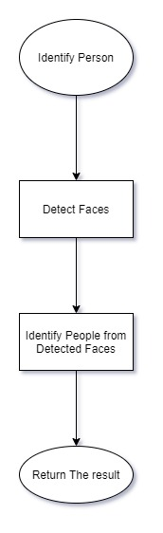
Identification of Face (Flow)

Slide 23
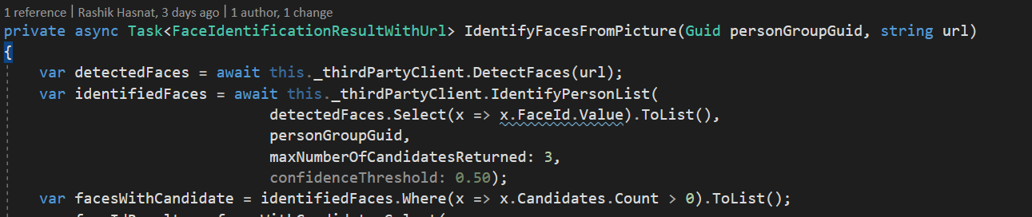
Identification of Face (Code)

Slide 24
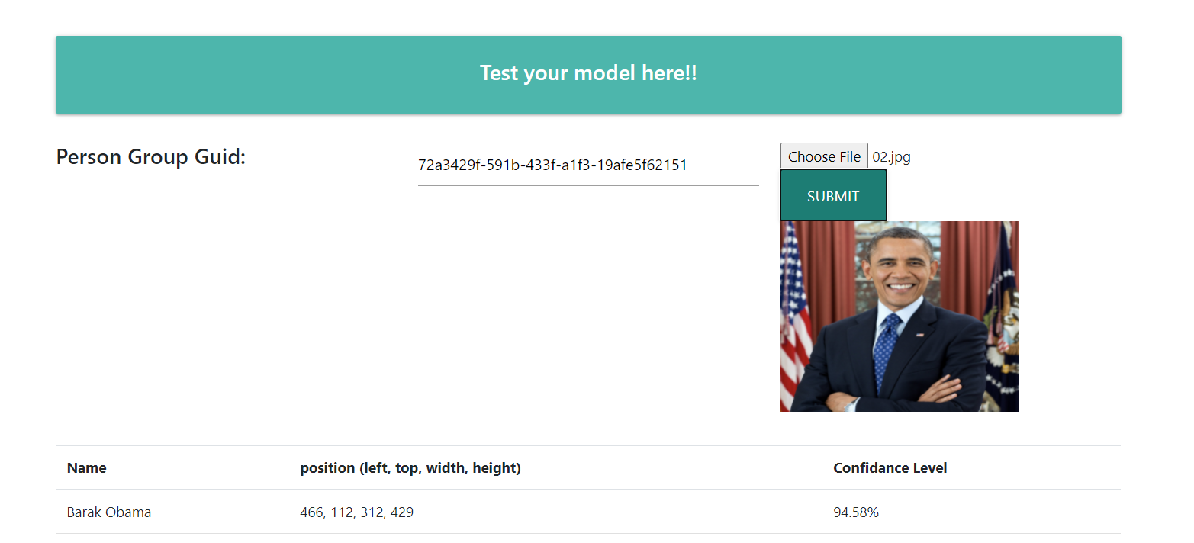
Identification of Face (Result)

Slide 25
Conclusion and Future Work
The method allows the visually impaired to not feel at a disadvantage when interpreting text that is not written in braille.
The image pre-processing section extracts the requisite text area from the complex context through Azure Cognitive Services.
Future work could include creating systems that track objects and retrieve text from videos rather than static images.

Slide 26
References
Abhinay, Badam, Eram Fatima Shaik, Mitadru Bera, Sharsha Vanria Thota, and Asha G. Hagargund. (2017). "Image to Speech conversion for Visually Impaired.“ International Journal of Latest Research in Engineering and Technology, 3(16), 09-15.
S. Venkateswarlu, D. B. K. Kamesh, J. K. R. Sastry, Radhika Rani [2016] Text to Speech Conversion. Indian Journal of Science and Technology, Vol 9(38), DOI: 10.17485/ijst/2016/v9i38/102967, October 2016.

Slide 27
THANK YOU!!

